Slide 1
Mushroom Classification Application

Slide 2
-Objective
The goal of this project is to develop a Mushroom classifier with a User-Friendly UI that helps us to predict if a mushroom is poisonous or not using Python and Machine Learning.
-Benefits
Detecting which mushroom is edible and which is not
Can be used as an educational tool to teach ML

Slide 3
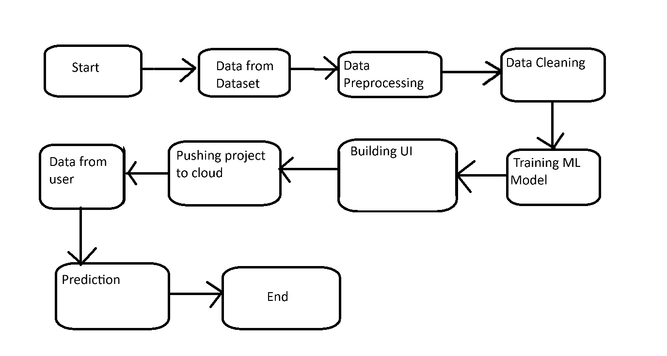

Slide 4
-Data Cleaning
Firstly we clean the data by checking for duplicate rows and also checking for empty cells
This is done with pandas
-EDA
We then use Matplotlib for exploring data using bar chart
-Model Training
We have to first OneHotEncode our data because it is categorical. Next we train out model using Logistic Regression.

Slide 5
-UI
We use flask to create our UI and to integrate our model with the application

Slide 6
Q/A
1) Why flask and not Streamlit?
-This is because Flask can easily be integrated with HTML, CSS and JS. It can also be scaled up easily
2) Why Logistic Regression?
-Since we are to predict binary data. We got an accuracy of 99.8%

